Slide 2
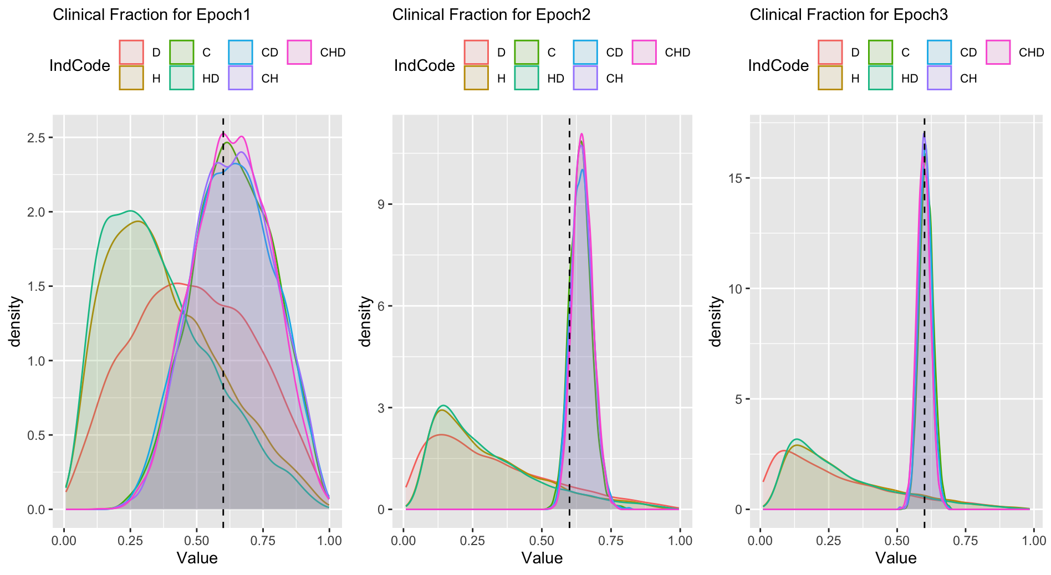
Stella
SEIRHD
1.
Generate
Synthetic
Data
Synthetic Data
readsdr
Cases
Hospitalisations
Deaths
2.
Estimate
Parameters
readsdr
Stan
Model
Run
Chains
Inference Results from 21 Experiments
ExpNumber - Epoch - IndCode - EpIndCode - Nindicators - Indicators - FitData - MM_readsdr - Divergent – Params - TS - RunTime
21 x 12
3.
Analyse
Results
Trace Plots, Fits, Boxplots
Quantiles, Overlapping

Slide 3
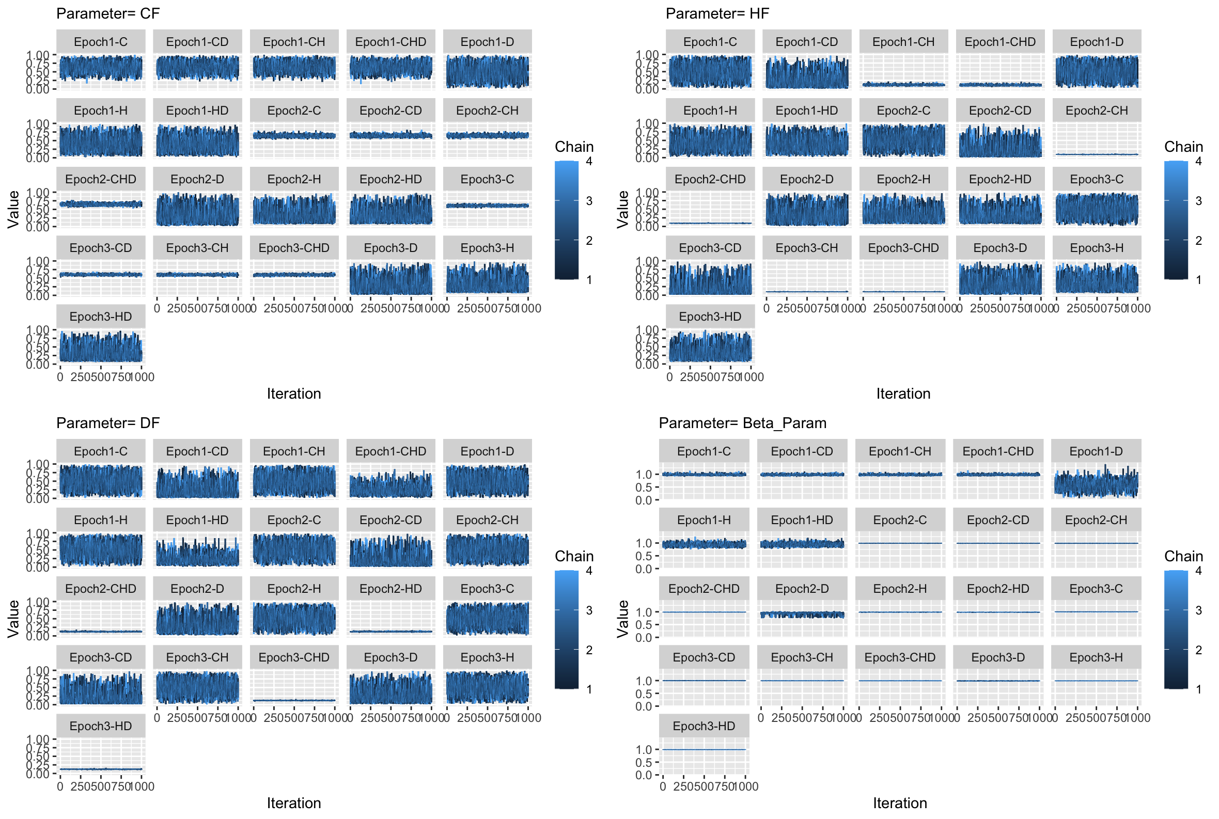

Slide 4
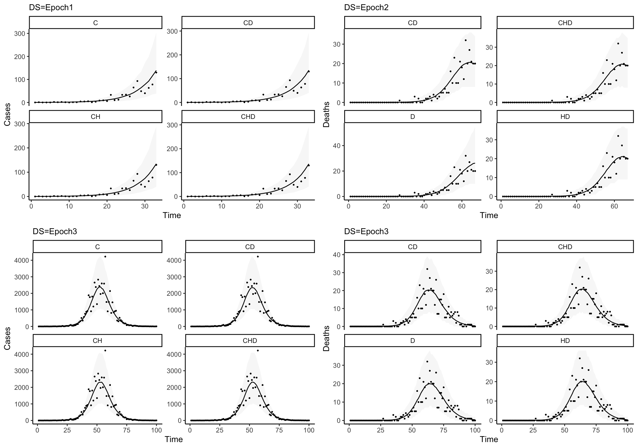

Slide 5
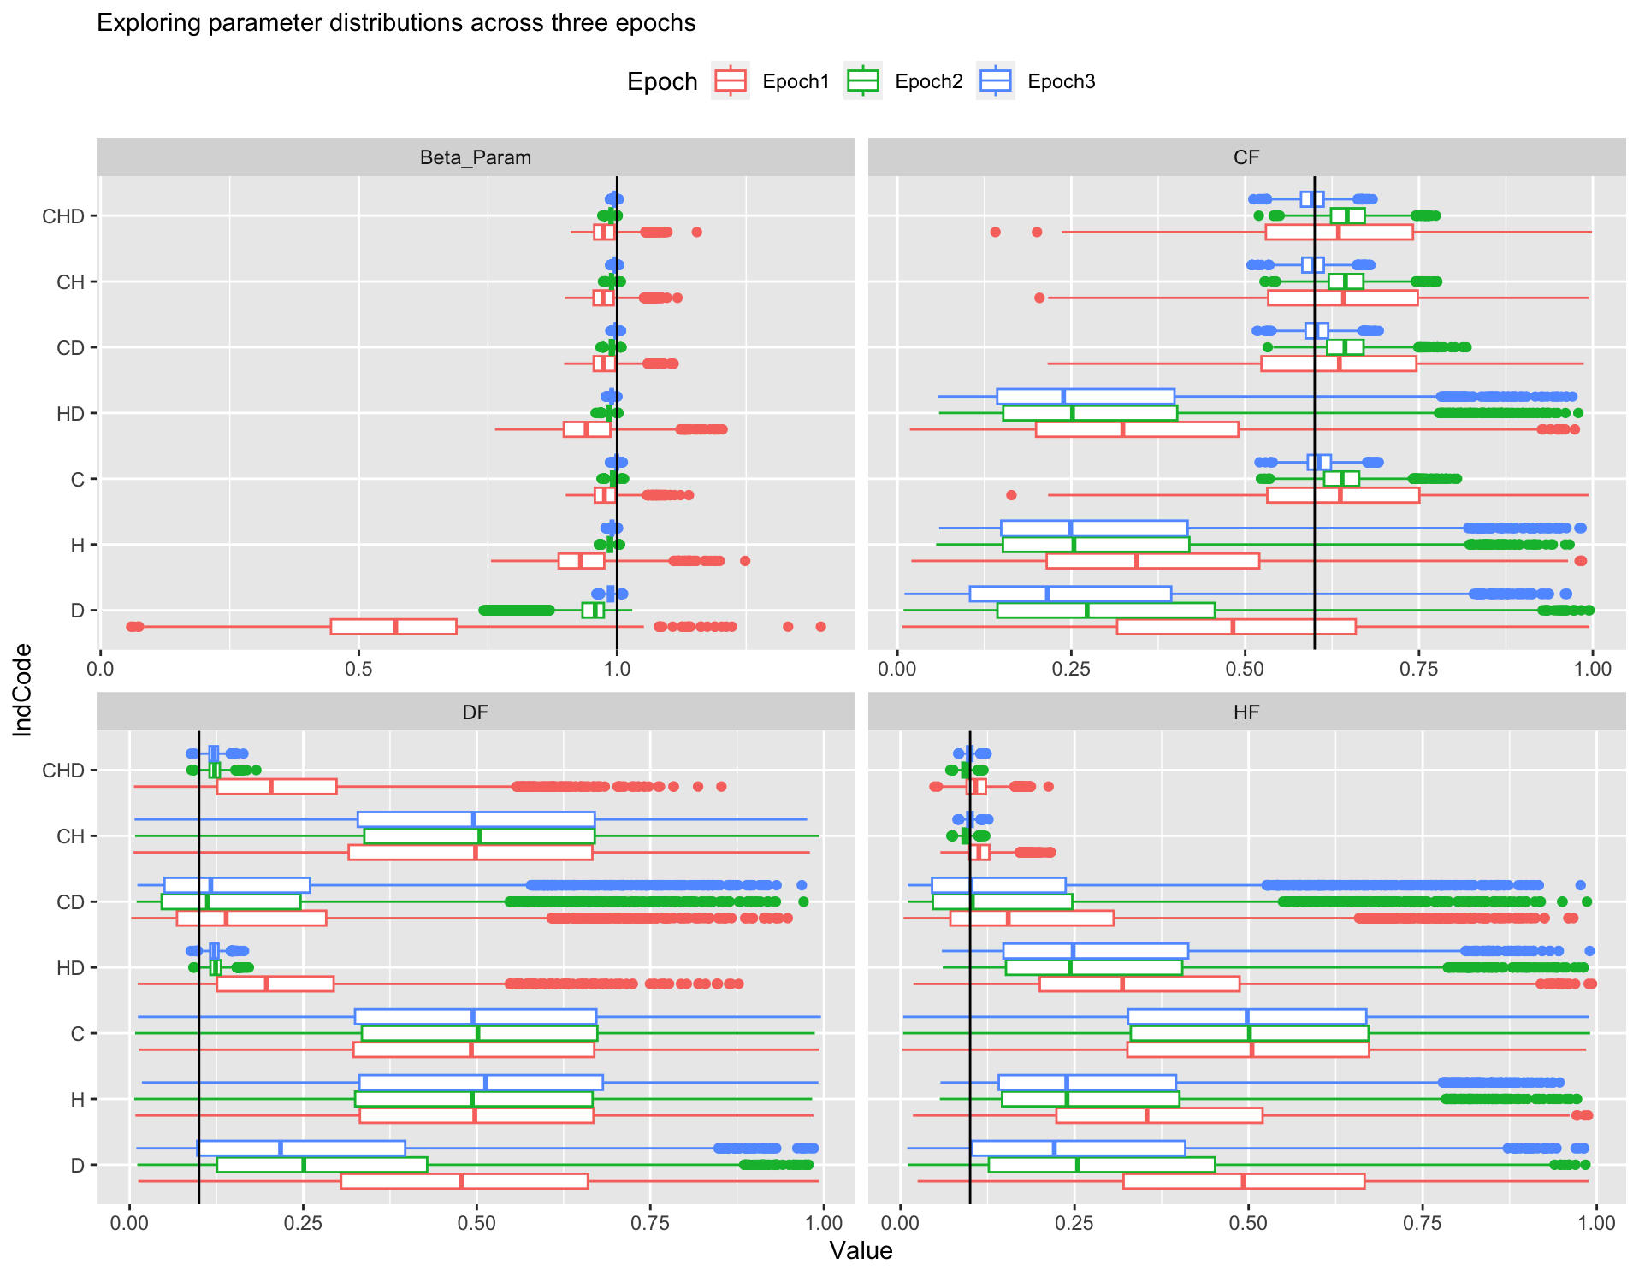

Slide 6
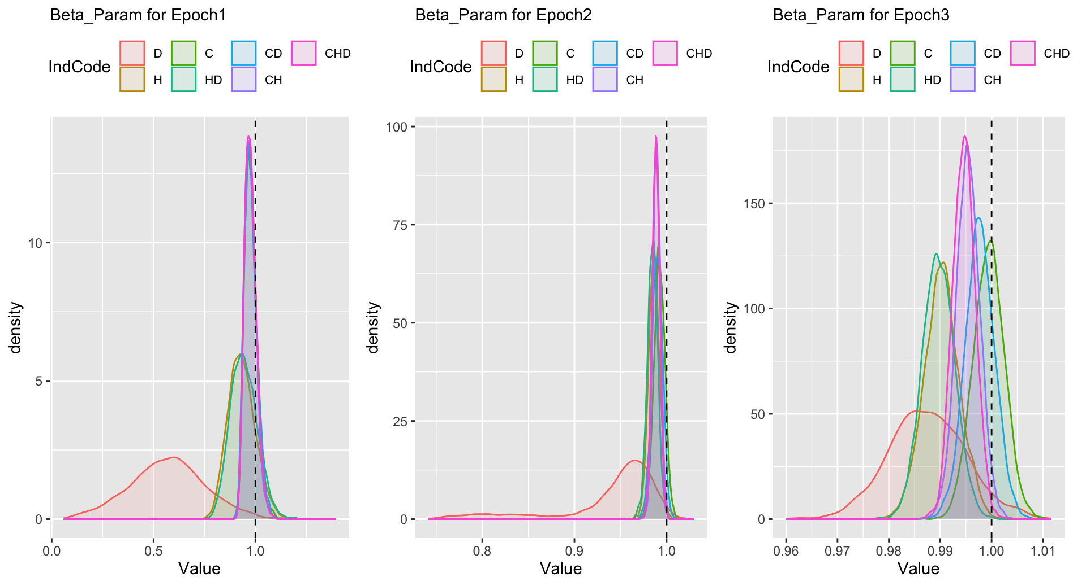

Slide 7
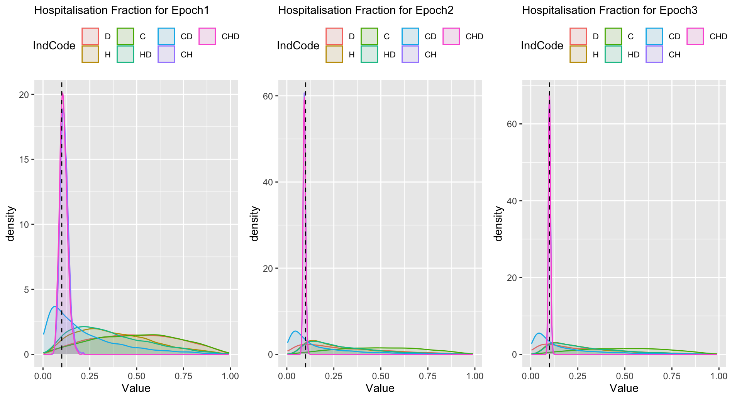
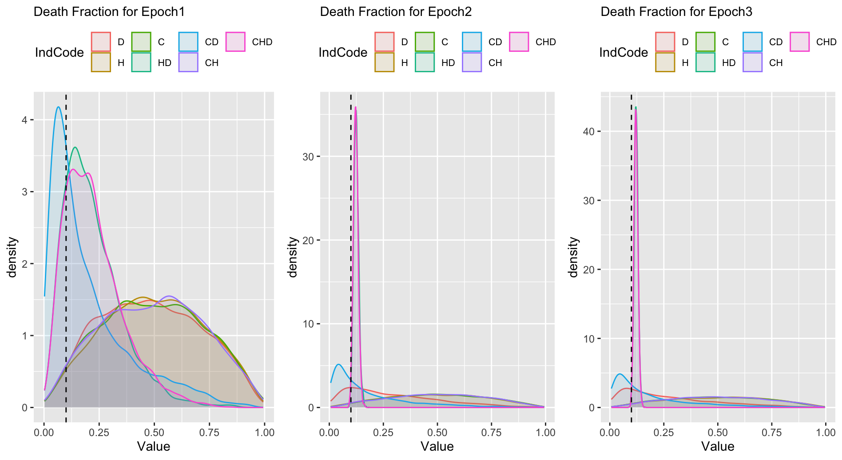

Slide 8
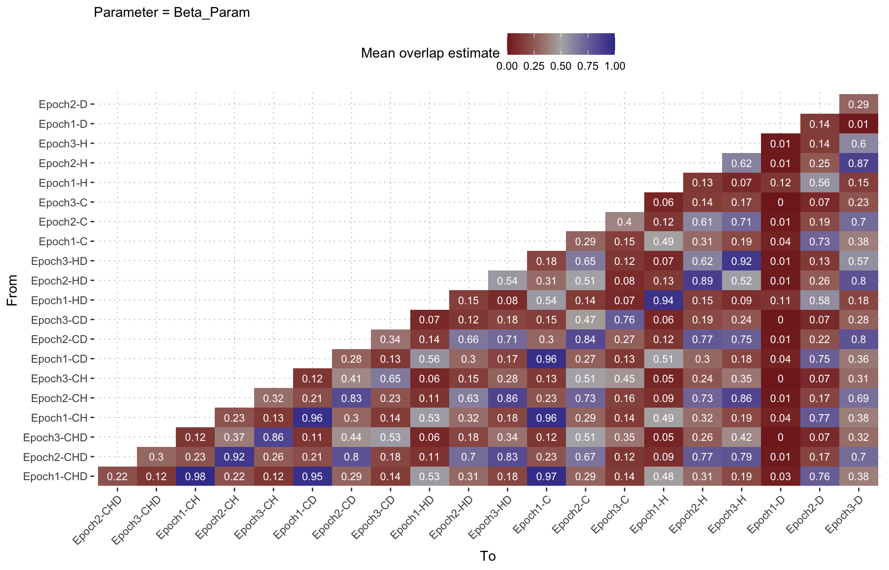

Slide 9
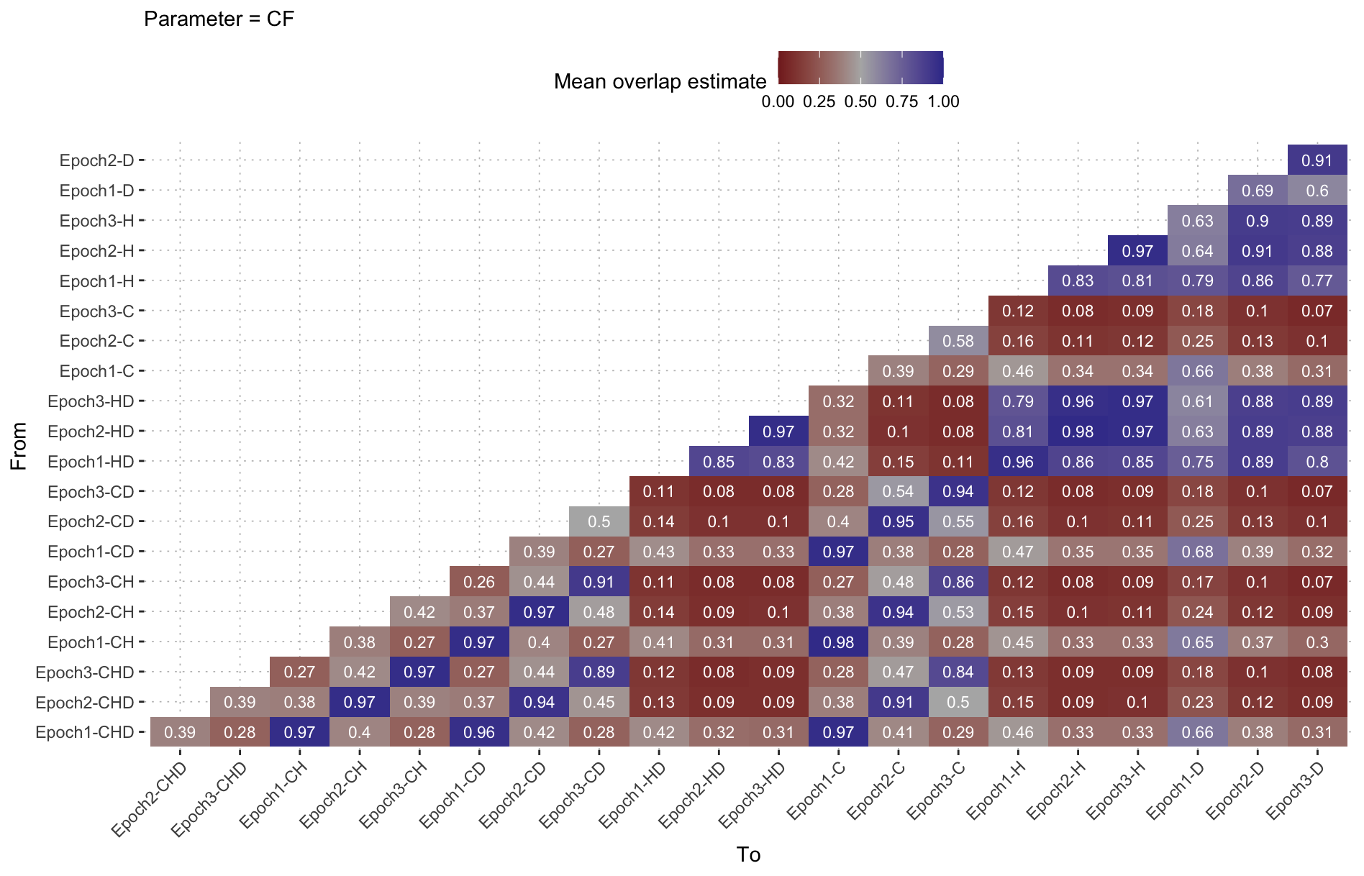

Slide 10
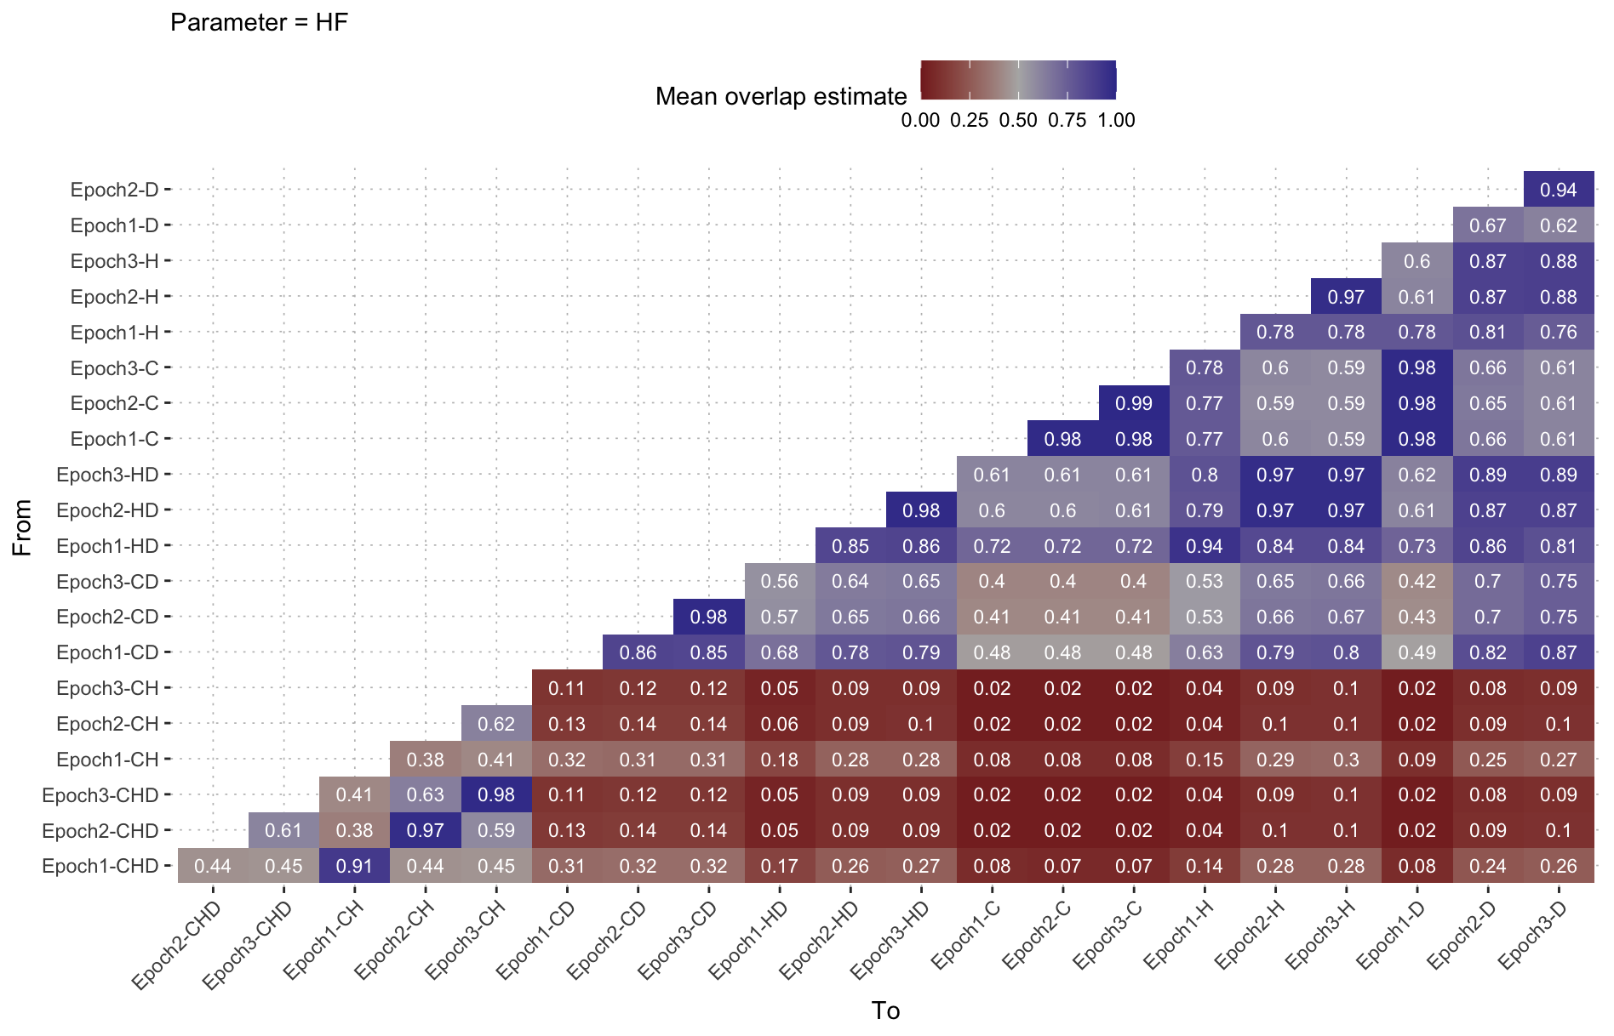

Slide 11
